Slide 1



Dip in 6
Lesson 14
Association game

Slide 2

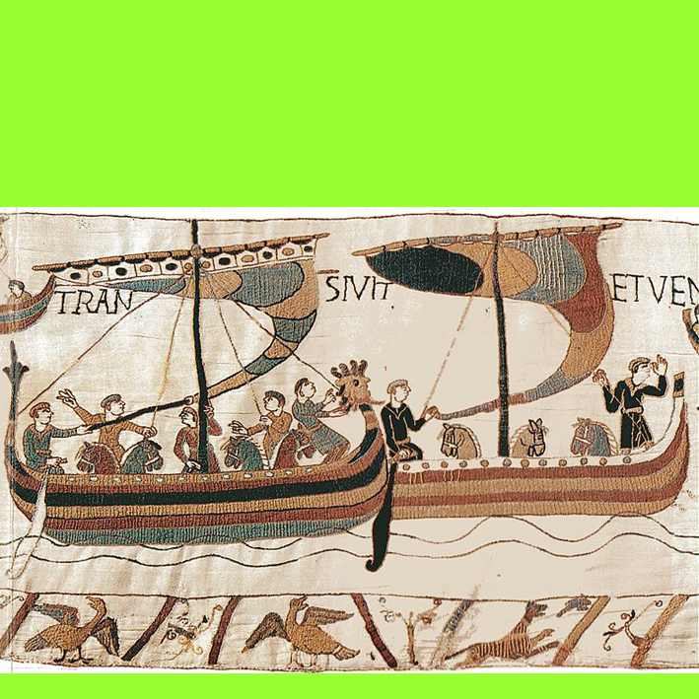
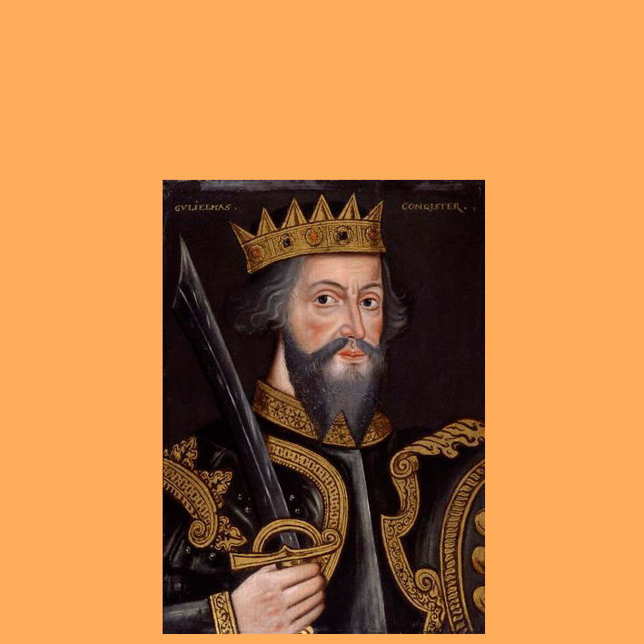


A1
Europe
B1
people
C1
prince…
D1
11th century
Liverpool
the Vikings
…of Normandy
A2
B2
C2
D2
a year
country
north
…the Conqueror
before 1067
A3
B3
C3
D3
A4
London
B4
France
C4
…Shakespeare
after 1065
D4
COLUMN A
COLUMN C
ENGLAND
COLUMN B
WILLIAM
THE NORMANS
1066
COLUMN D
THE FINAL ANSWER
THE BATTLE OF HASTINGS

